Slide 1

CMS workshop series
PART 3 | TABLETOP EXERCISE (TTX) PLANNING MEETING
TUESDAY, OCTOBER 6, 2020

Slide 2
Virtual use guidelines
Trainings must be accessed by a computer only, no phone line option is available
All participants need to MUTE their microphones unless speaking to the group
For Questions: unmute your microphone or use the chat feature Training will be recorded
This platform is internet based, deliverability may vary
All participants have the option of using the APPLICATION version or the Web Based version
Notes:
Day of checklist to make sure systems work– send out ahead of time too

Slide 3
disclaimer
Any recommendations provided by NSPA are provided strictly as recommendations and facilities are under no obligation to comply with said recommendations. Participation in this exercise series does not guarantee approval by certification/licensing agencies or the ability of a facility to adequately respond to an emergency and should not be construed as being approved by CMS, VDH Office of Licensure and Certification, or other licensing, certifying, or governing body.
It is the responsibility of the healthcare facility to ensure that they are adequately prepared to respond to an emergency and have met all provisions of licensing and certifying agencies.
Notes:
Failure for technological implementation is on you-

Slide 4
2020 workshop series
Part 1 | Virtual Training Platform Orientation (optional)
  September 17th & September 22nd – recording available
Part 2 | Hazard Vulnerability Assessment (optional)
  September 29th – recording available
Part 3 | Tabletop Exercise (TTX) Planning Meeting
  Today, Tuesday October 6th – prerequisite to Tabletop Exercise
Part 4 | Tabletop Exercise
  Tuesday, October 20th 12:30-4:00pm
  Wednesday, October 21st 8:30am - 12:00pm
  Thursday, October 22nd 12:30-4:00pm
Part 5 | After Action Review Workshop
  Tuesday, November 10th 10:00a-1:00pm

Slide 5
Emergency preparedness rule
September 2019 Changes
  http://nspa1.org/wp-content/uploads/2019/10/CMSchanges2019.pdf : Rule
  http://nspa1.org/wp-content/uploads/2019/10/CMSrule2019interp.pdf : Interpretation
COVID-19
  September 2020 Memo: http://nspa1.org/wp-content/uploads/2020/10/QSO-20-41-ALL-508.pdf
Workshop Series Changes

Slide 6
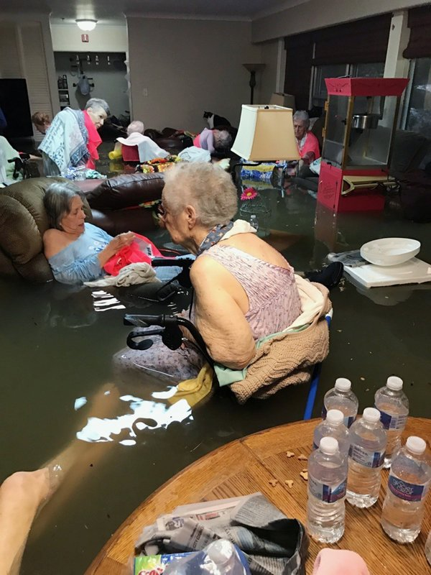
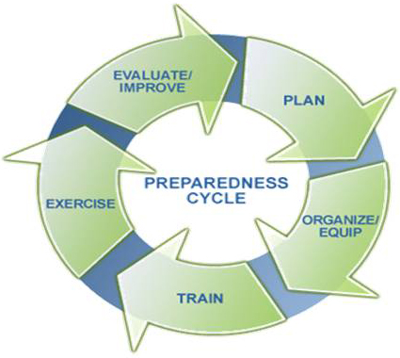
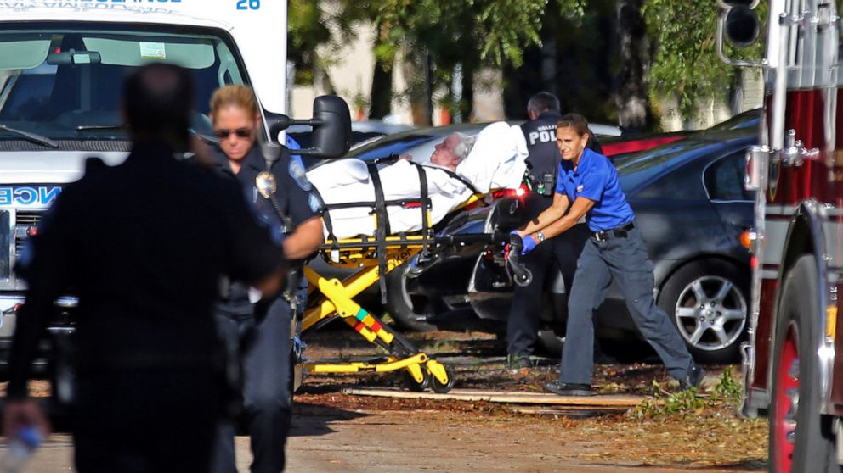
Why
Why do we prepare?
Why do we exercise?
Why do Organization’s
take time to prepare?

Slide 7
2020 Theme
“RETHINKING CONTINUITY”
WHAT IS CONTINUITY?
HOW DOES IT APPLY TO YOUR ORGANIZATION’S PREPAREDNESS?
WHAT IS THE DIFFERENCE BETWEEN EOP & COOP?
Notes:
This TTX Exercise series is intended to help you identify, discuss, and plan for the continuity of your essential elements of operations and critical business functions when normal operations have been disrupted; (i.e. COVID-19!)
We recognize that many organizations may not have fully developed these plans that should coexist with your Emergency Operations Plan. This table top exercise should help you understand the differences, and give you the tools you need in order to continue to provide essential healthcare, services, and other activities.

Slide 8
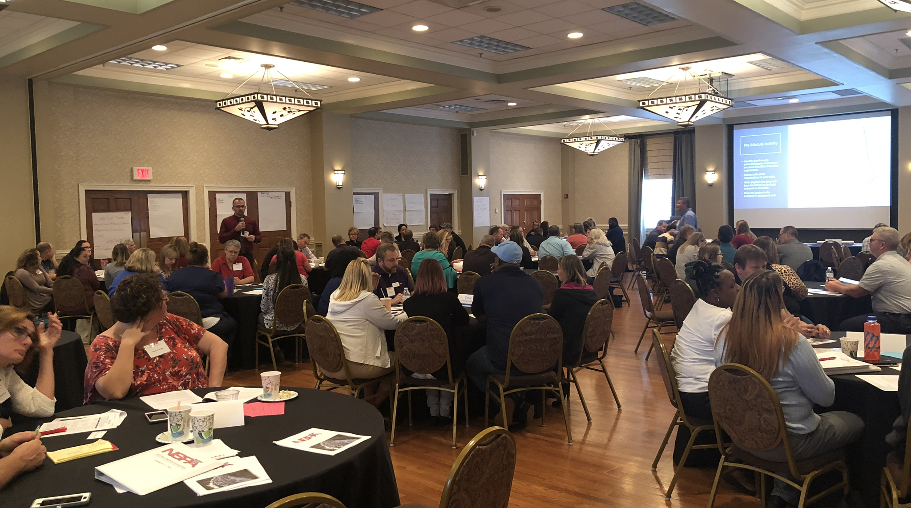
Tabletop exercise (ttx)
What is it?
Why do one?

Slide 9
objectives
Objective 1:
  Identify internal limitations associated with current COVID-19 operations
Objective 2:
  Identify external opportunities associated with COVID-19 operations
Objective 3:
  Analyze current sustainment strategies
Objective 4:
  Analyze organizational de-escalation strategies
Objective 5:
  Identify current recovery planning processes

Slide 10
Ttx: rethinking continuity
SCHEDULE
  T= -0.30 Registration
  T = 0.00 TTX Rules & Guidelines
  T = 0.15 – 2:25 Modules / Breakout Discussions
  T = 2:25 Hot Wash
Built In Time for Breaks
Single Connection
One Spokesperson

Slide 11
documentation
NSPA will provide:
Your Responsibility:
Letter of Support
Attendance Logs
Participant Situation Manual
AAR Template
Letter to Surveyors detailing effort and certification of completion
Sign In Sheets
Lessons learned and improvement plans (IP) for the AAR documents
Final / permanent custodial duties for documentation

Slide 12
TTx checklist & homework
Review / Have Available for Exercise
  Continuity of Operations Plans (COOP) if applicable
  Emergency Operations Plan (EOP)
  Notes from previous events and exercises; including COVID-19 response notes
  Most recent Hazard Vulnerability Analysis (HVA)
Identify 5 of your Organizations Critical Business Functions / Essential Operations or Activities
Make sure you are able to use Adobe Connect Platform PRIOR to day of TTX
Notes:
Give examples of what critical business functions look like
Use Example for technical difficulties (IT issues)

Slide 13
Connect with us
Website: www.nspa1.org
Tuesday Newsletter: www.nspa1.org/brief
Thursday Newsletter: www.nspa1.org/register
Virginia Healthcare Alerting & Status System (VHASS): www.vhass.org
Social Accounts | Facebook: @NSPA01 | Twitter: @NSPA01
RHCC Emergency Activation Number: 1-866-679-7422 | 1-866-679-RHCC

Slide 14


Slide 15

Questions?

