Slide 1
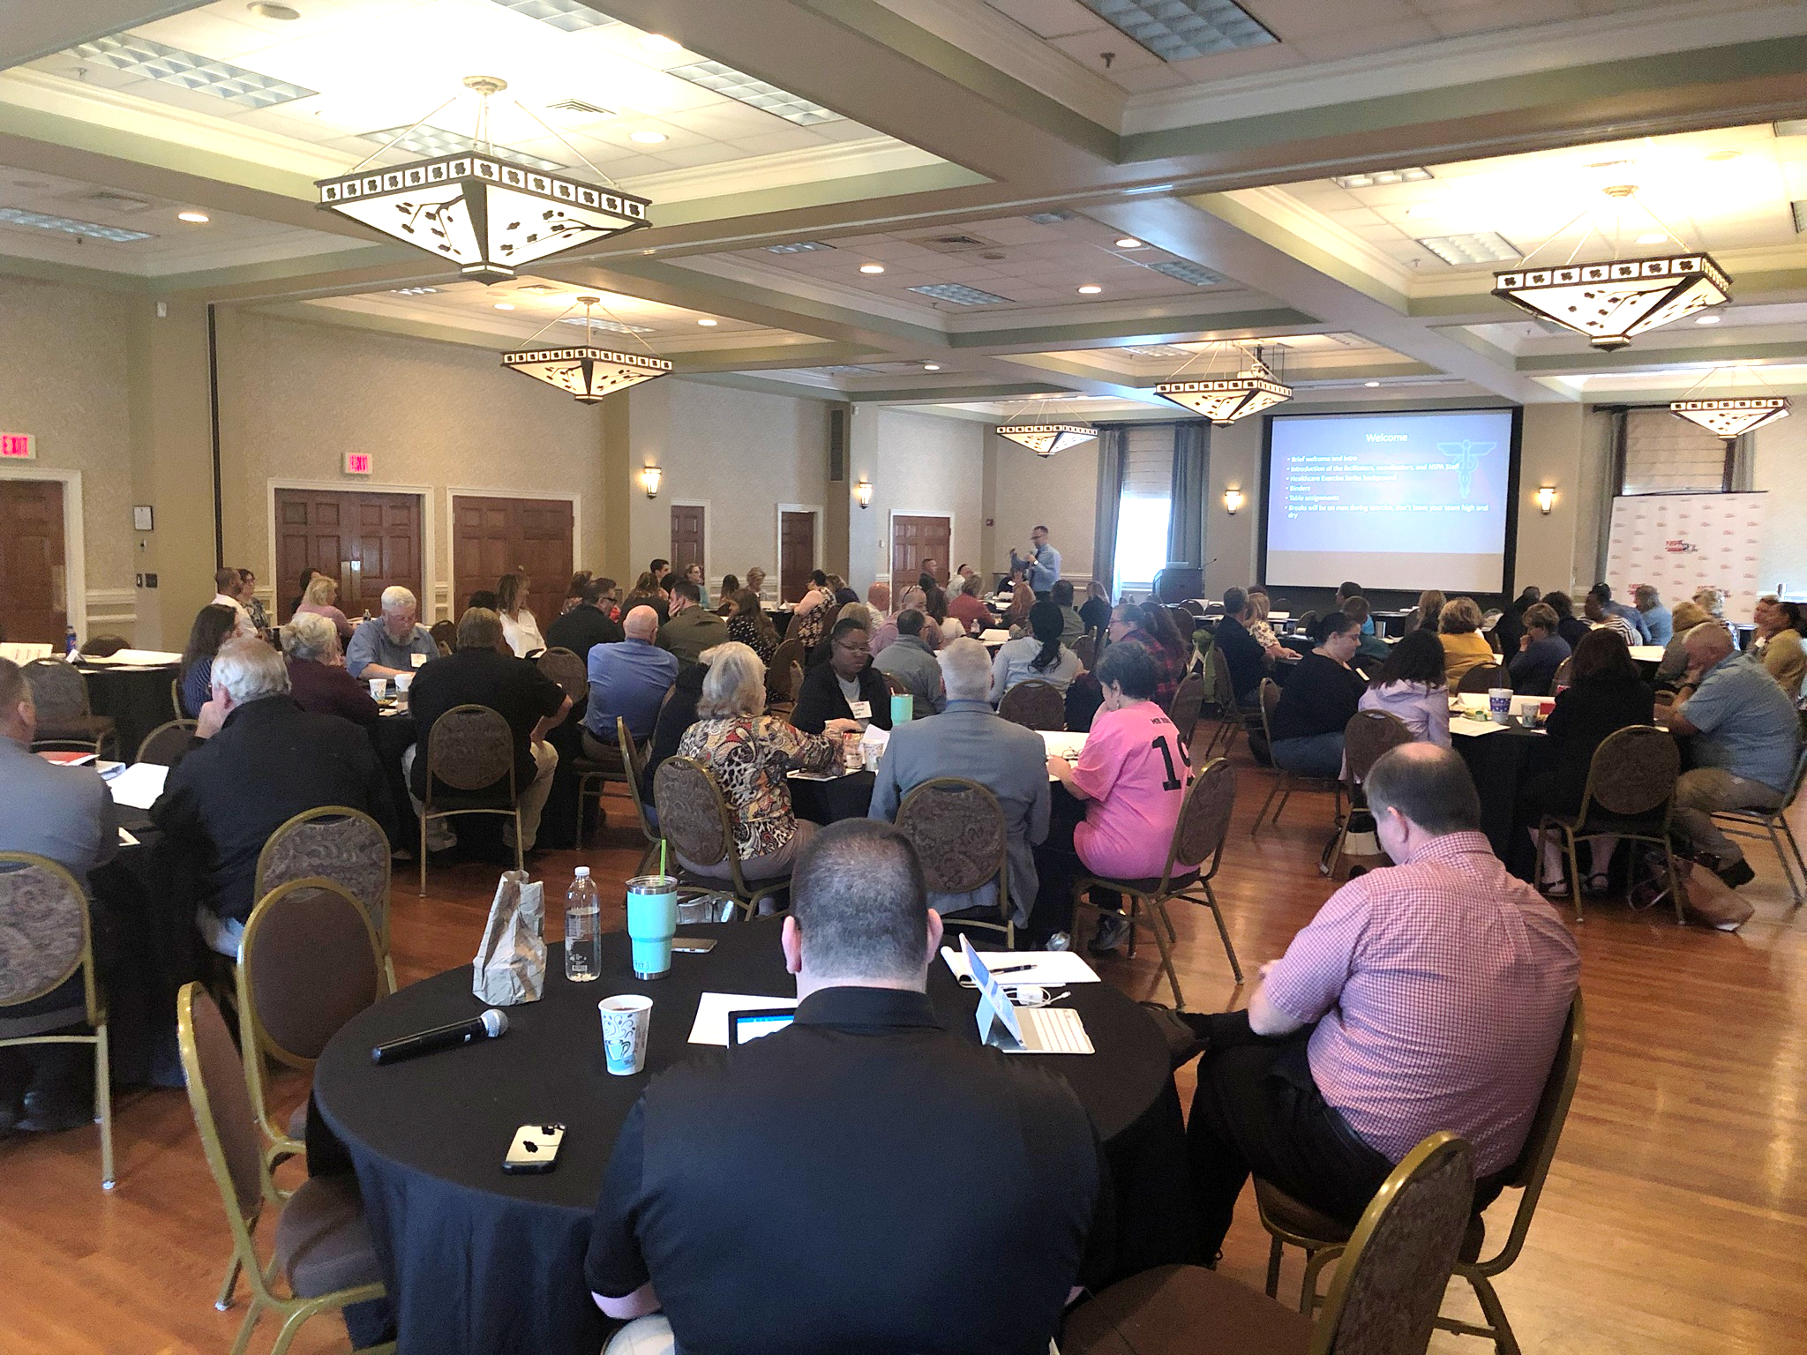

CMS Workshop Series 2019
Supply Chain Disruption

Slide 2


NSPA Healthcare Exercise Series
October 2020

Slide 3
Welcome
Brief welcome and intro
Introduction of the virtual platform
Healthcare Exercise Series background
Binders
  Organizational duties
Breakout Room assignments
Breaks will be on your own during exercise, don’t leave your team hanging

Slide 4
What is Continuity?
Plan of established policies and procedures that ensure critical and essential functions continue during natural or man-made disasters.
Identifies
  Essential Functions
  Order of Succession
  Delegated Authority
  Vital Records Management
  Human Capital
  Recovery
May be within your EOP or as a separate COOP plan

Slide 5
What is Continuity?
Four Phases of Continuity
  Phase 1: Readiness and Preparedness
  Phase 2: Activation and Relocation
  Phase 3: Continuity Operations
  Phase 4: Reconstitution

Slide 6
A few important things..
“NO FAULT” Environment
Work together
Interact with your breakout room partners
  Discussion is key
  Members may not be from your organization, so learn from each other
Enjoy yourself

Slide 7
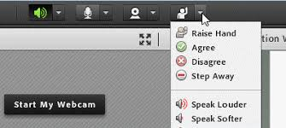
A few important things..
  Adobe Platform Capabilities Reminder
  On Mute
  Raise Hand Feature or Chat Feature for Questions during presentation
  Recording Attendance
  Audio Reminder

Slide 8
Exercise Objectives
Listed in your participant Situation Manual
Think in terms of your organization’s response to COVID-19…
…but expand it to other threats from infectious disease.
Capture your opportunities for improvement (and your strengths) now
DON’T WAIT until COVID-19 response has “ended”.ry

Slide 9
Exercise Rules and Expectations
This is a no-fault learning environment used for the evaluation of plans and processes. There will be no recording of today’s session.
The exercise scenario is plausible (you may, or may not, already be in it), and the events occur as they are presented.
  (“Don’t fight the scenario”)
The scenario is presented with enough detail to allow players to react to information and situations as presented. (The emphasis is on the effects to your facility rather than the cause)
Due to virtual platform, modules will be given by facilitator (controller) at specific times to maintain engagement and learning
Everyone is expected to participate. Feedback and discussion is vital, as are the questions you will generate about your plans.

Slide 10
Exercise Agenda
Pre-Module Discussion or Activity
Modules
  Three (3) specific modules
  Separated into phases
  Participants work together in breakout rooms
  Will come back together for discussion
  Spokesperson or facilitator will share info from the breakout discussions
Debrief / “Hotwash”

Slide 11
Time to Begin
Any Questions?
Ready? 3, 2, 1….Go.

Slide 12

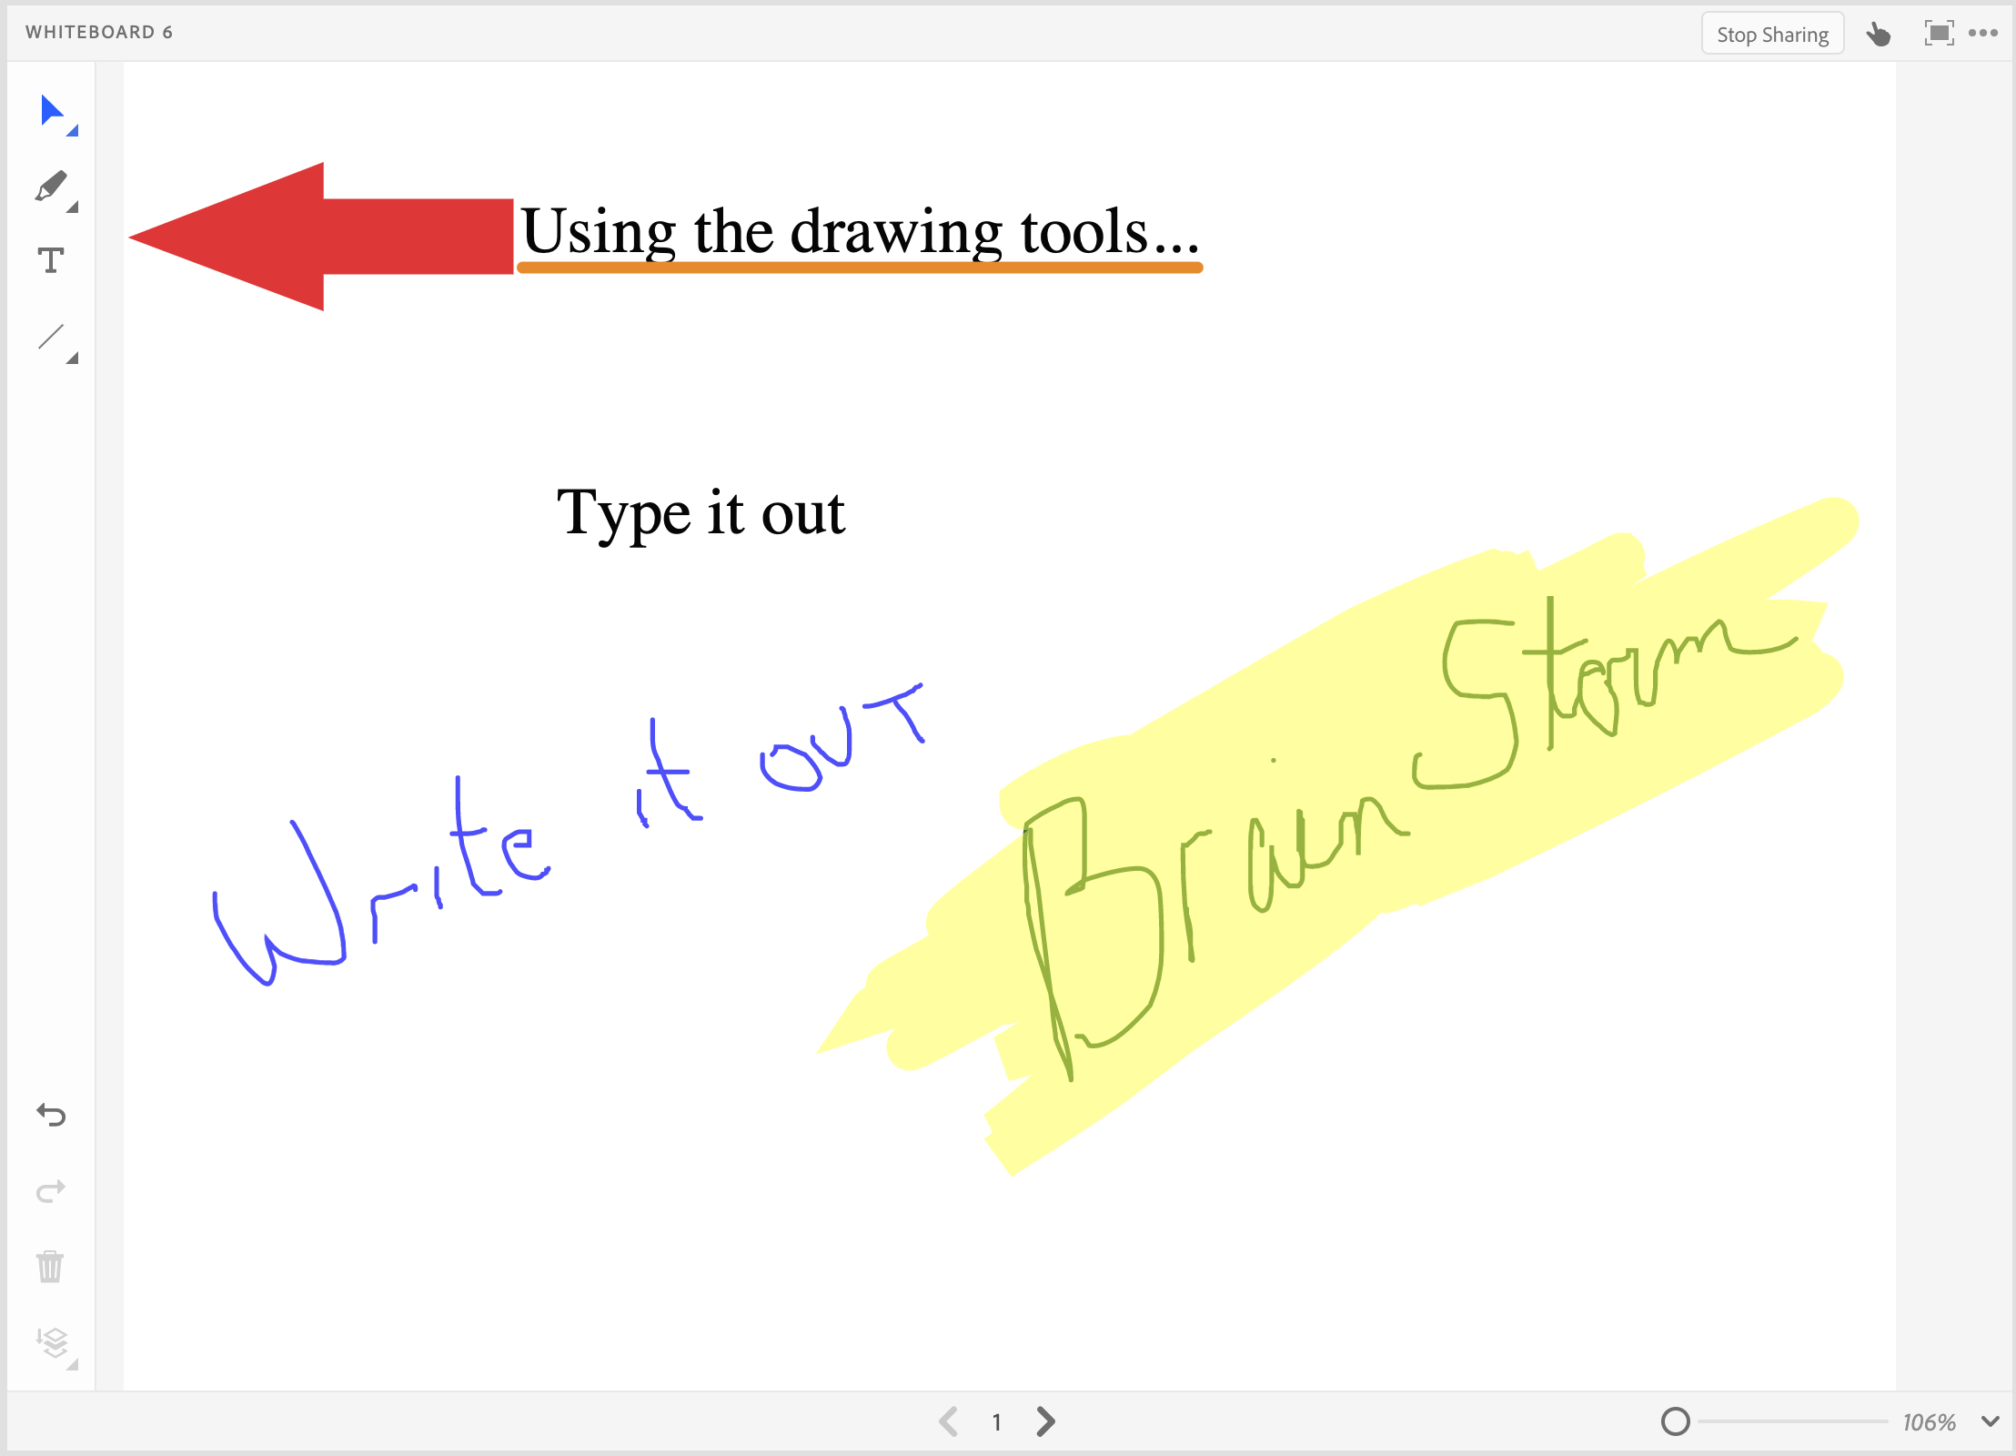
Pre-Module Activity
Identify the five (5) organizational concerns you have identified over the last few months of COVID-19. Discuss with others in your breakout rooms
Utilize the chat, open line, and whiteboard feature in your rooms for discussion
Your whiteboard will be brought back to main screen for discussion

Slide 13
Module #1
Facility Continuity
Your facility HAS NOT been directly impacted by the infectious disease (i.e. Covid-19).
Your facility HAS BEEN directly affected by the infectious disease (i.e. Covid-19).
Breakout Groups

Slide 14
Module #1
Facility Continuity
Your facility has NOT been directly impacted by the infectious disease (i.e. Covid-19).
  What are your facility's concerns?
  What steps can you take to prepare from a facility point of view?
  Does your current Continuity of Operations Plan (COOP) prepare your facility for maintenance of operations?
  Short Term? Long Term?

Slide 15
Module #1
Facility Continuity
Your facility HAS been directly affected by the infectious disease (i.e. Covid-19).
  What are your facility's concerns?
  Did your concerns change? How?
  Does your current Continuity of Operations Plan (COOP) prepare your facility for maintenance of operations?
  At what point do you activate your COOP or EOP?
  Based on your experience thus far. What were your “blind sides”?

Slide 16
Take a break!!
You’ve earned it!

Slide 17

Module 1:
Facilitated Discussion…

Slide 18
Module #2
System Continuity
Your facility’s system have not been directly impacted by the infectious disease (i.e. Covid-19). (Supply chains, patient management, healthcare records, Information sharing, etc..)
Your facility’s systems have been directly affected by the infectious disease (i.e. Covid-19). (Supply chains, patient management, healthcare records, Information sharing, etc..)
Breakout Groups

Slide 19
Module #2
System Continuity
Your facility’s system have NOT been directly impacted by the infectious disease (i.e. Covid-19).
  What systems do you rely on?
  Were these system stable prior to facility impact?
  What systems are disrupted even prior to a direct impact?
  What are your contingencies?
  What preparedness steps an you take before impact?
  Did your COOP or EOP address these points?

Slide 20
Module #2
System Continuity
Your facility’s systems HAVE been directly affected by the infectious disease (i.e. Covid-19).
  What systems do you rely on?
  Were these system stable prior to facility impact?
  How well did your contingencies work?
  Did your COOP or EOP address these points?
  What were your “blind sides”?
  What changed between before and after?

Slide 21
Take a break!!
You’ve earned it!

Slide 22
Module 2:
Facilitated Discussion…

Slide 23
Module #3
Staffing Continuity
Your facility has not been affected by an infectious disease (currently COVID-19). What are there potential direct and/or indirect effects to facility staffing (i.e. clinical and non-clinical staff, leadership, succession and delegation of authority)?
Your facility has been affected by an infectious disease (currently COVID-19). What are issues / concerns to staffing that have occurred or potentially could occur in the future (i.e. clinical and non-clinical staff, leadership, succession and delegation of authority)?
Breakout Groups

Slide 24
Module #3
Staffing Continuity
Your facility’s system have NOT been directly impacted by the infectious disease (i.e. Covid-19).
  What are staffing concerns that you could consider?
  Was staffing stable prior to facility impact?
  What are your contingencies?
  What preparedness steps an you take before impact?
  Did your COOP or EOP address these points?

Slide 25
Module #3
Staffing Continuity
Your facility’s systems HAVE been directly affected by the infectious disease (i.e. Covid-19).
  How did your staffing process change?
  What are your contingencies?
  How did your facility adjust?
  Did your COOP or EOP address these points?
  What were your “blind sides”?
  What changed between before and after?

Slide 26
Take a break!!
You’ve earned it!

Slide 27
Module 3:
Facilitated Discussion…

Slide 28
“Hotwash”
“Hotwash” definition
“What did you know and when did you know it?”
Emergency Management Landscape
AAR and Next Steps

Slide 29
After Action Review
For today’s discussion
  What was supposed to happen?
  What actually happened?
  What did we learn?
  What is our plan for improvement?
In progress review
Our AAR Workshop will assist you more with the document and process.
  Tuesday, November 10th 10:00am-1:00pm

Slide 30
Final Points and Questions
What are your “takeaways”?
You are not expected to have all the answers.
This cycle and discussion will continue.
As this applies to Covid-19, this isn’t over
… so keep working your processes.

Slide 31
NSPA Contacts
Robert Hawkins, NSPA Executive Director
rhawkins@vaems.org
Mark Cromer, RHCC Manager
mcromer@vaems.org
Monica McCullough, Training and Exercise Coordinator
mmcullough@vaems.org
Mary Kathryn Alley, Medically Vulnerable Populations Coordinator
mkalley@vaems.org

Slide 32
NSPA Resources
Weekly Situational Brief
www.nspa1.org/brief
NSPA Listserv
www.nspa1.org/register
NSPA Website
www.nspa1.org
  Virginia Healthcare Emergency Management
  www.vhass.org

