Slide 1

Rethinking Continuity
After Action Report Development Workshop

Slide 2

Agenda
After Action Reports (AAR) 101
Applying the AAR Process to Continuity of Healthcare Service Delivery
  Facility Continuity
  System Continuity
  Staffing Continuity
Improvement Planning
  Facility Continuity
  System Continuity
  Staffing Continuity
Hotwash
Closing

Slide 3

Terminal Learning Objective
Participants should be able to develop an After Action Report and Improvement Plan for their agency, entity, organization or system that supports ongoing preparedness at the individual, facility and coalition level.

Slide 4
Assumptions & Acknowledgements
The incident is still evolving and ongoing and will likely continue for the foreseeable future.
We realize that there are many issues that are state/regional in nature outside of your control.
Focus today on items that pertain to your facility, system, agency or organization.
Perfection is not an expectation!

Slide 5
Discussion Question 1
Did you participate in the Cardinal Resolve tabletop exercise in July 2019?
Did you participate in the NSPA supply chain disruption exercise series in the fall of 2019?
Have you been participating in the current NSPA CMS “rethinking continuity” exercise to date?

Slide 6
Discussion Question 2
At the onset of COVID, what were the initial response objectives of your:
  Facility
  Agency
  System

Slide 7
MODULE 1
After Action Reports 101

Slide 8
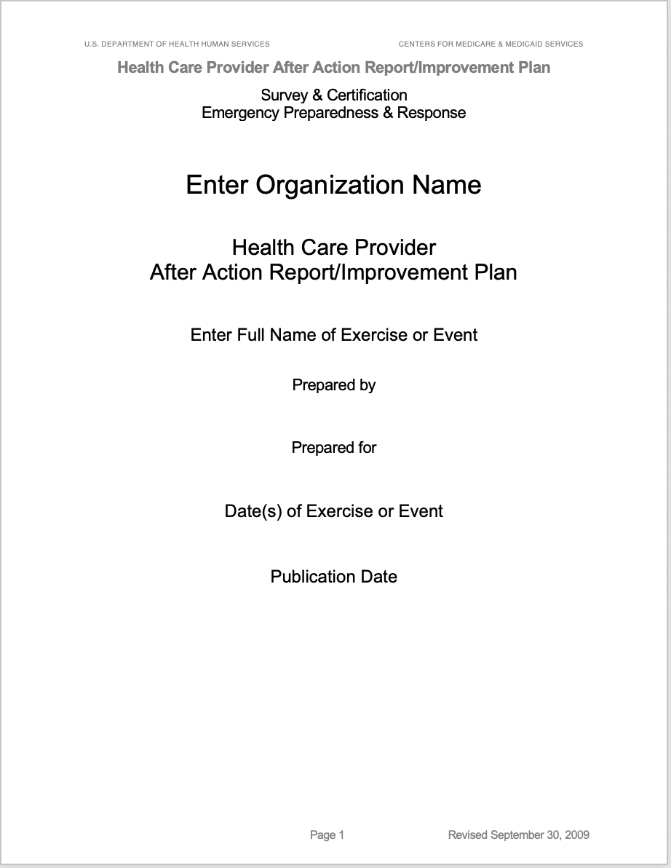
What is an After Action Report & Improvement Plan? (AAR/IP)
The AAR is a document that:
  Includes an overview of the event
  Analysis of capabilities
  List of corrective actions

Slide 9

CMS Defined AAR Requirements
What was supposed to happen?
What did happen?
What went well?
What need to be improved?
Improvement Plan for areas noted

Slide 10
CMS Defined AAR Requirements (Cont.)
Develop a narrative description of the lessons learned from the event
Focus time and detail describing gaps in planning and needed improvements.
Discussion Question:
  What is an example of a gap in planning that someone discovered?

Slide 11

So how do we get there?

Slide 12
AAR Process
Observation
Data Collection & Analysis
Improvement Planning

Slide 13

Observation

Slide 14
Observations
Activation or implementation of plans, policies, processes, and procedures, requests for resources, use of mutual aid agreements, etc.
Roles and responsibilities and authorities of the government agencies, jurisdictions, and private organizations
Pertinent decisions made or decision-making processes
Information sharing with other agencies and the public.

Slide 15
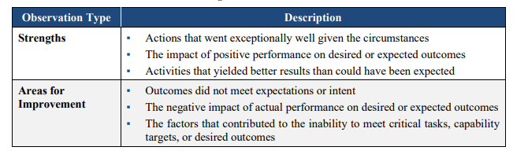
Categories of Observation

Slide 16
Incorporating Observations into the AAR
Focus on issues that are critical to the success of your mission
Observations help guide corrective action planning by focusing time and resources on issues that have the greatest impact to preparedness
Include data on consequences and likelihood of recurrences on what would happen if no action was taken
Discussion Question 3:
  Can someone provide examples of issues that they discovered that meet these definitions?

Slide 17

Data Collection & Analysis

Slide 18
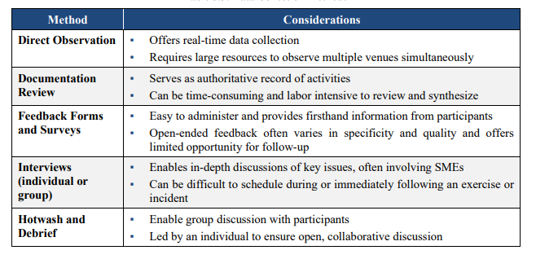
Data Collection: How do you do it?

Slide 19
Discussion Question 4
Of the methods of data collection listed on the previous slide:
  How many of these have you or will you use to develop your After Action Report?
  Are there any other methods of data collection that you have used or plan to use that aren’t listed?

Slide 20
Root Cause Analysis
Focuses on identifying the most basic casual factor for why something did or did not occur during the event.
Performing the Root Cause Analysis allows for determination of the cause of an issue and allows for the direction of improvement of a specified issue.

Slide 21
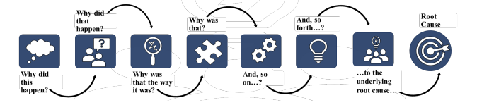
Root Cause Analysis (Cont.)
Consider asking the follow questions to narrow down the issue of concern:
  Were specific tasks met? If not, what factors contributed to his result?
  Did discussions or activities suggest tasks were performed sufficiently? If not, what were the impacts of consequences?
  What improvements are required? Are other resources needed? How will they be obtained?
  What strengths are required to carry out this task? What decisions would need to be made and who would make them?

Slide 22


BREAK

Slide 23
MODULE 2
Applying the AAR Process to Continuity of Healthcare Service Delivery

Slide 24
Instructions
15 Minute each, Facility, System, Staff breakouts based on the outline of modules from the TTX’s
Using the Root Cause Analysis process
  Begin discussions on developing root causes for your response(s) to serve as the basis for your facility AAR.

Slide 25
Facility Impact
Facility NOT impacted
My facility has not been affected by an infectious disease (currently COVID-19). Due to current emerging infections in Virginia are there potential direct and/or indirect effects to my facility?
  Q1: Are there new facility concerns that come to mind?
  Q2: Of the concerns you have identified which ones are facility focused?
  Q3: Does your current Continuity of Operations Plan (COOP) prepare your facility for maintenance of essential functions short term; long term?
Facility Impacted
My facility has been affected by an infectious disease (currently COVID-19). Due to current emerging infections in Virginia are what issues / concerns to my facility that have occurred or potentially could occur in the future?
  Q1: Are there new facility concerns that come to mind?
  Q2: Of the concerns you have identified which ones are facility focused?
  Q3: Does your current Continuity of Operations Plan (COOP) prepare your facility for maintenance of essential functions short term; long term?

Slide 26
System Impact
My facility systems have not been affected by an infectious disease (currently COVID-19). Due to current emerging infections in Virginia are there potential direct and/or indirect effects to my systems (supply chain, healthcare records, etc.)?
  Q1: Are there new system concerns that come to mind?
  Q2: Does your current Continuity of Operations Plan (COOP) prepare your facility for system impacts and maintenance of essential functions short term; long term?
My facility systems have been affected by an infectious disease (currently COVID-19). Due to current emerging infections in Virginia are what issues / concerns to my systems that have occurred or potentially could occur in the future (i.e. supply chain, healthcare records, etc.)?
  Q1: Are there new system concerns that come to mind?
  Q2: Does your current Continuity of Operations Plan (COOP) prepare your facility for system impacts and maintenance of essential functions short term; long term?

Slide 27
Staff Impact
My facility has not been affected by an infectious disease (currently COVID-19). Due to current emerging infections in Virginia are there potential direct and/or indirect effects to facility staffing (i.e. clinical and non-clinical staff, leadership, succession and delegation of authority)?
  Q1: What are staffing concerns that your facility should be considering?
  Q2: Does your current Continuity of Operations Plan (COOP) prepare your facility for system impacts and maintenance of essential functions short term; long term?
My facility has been affected by an infectious disease (currently COVID-19). Due to current emerging infections in Virginia what are issues / concerns to staffing that have occurred or potentially could occur in the future (i.e. clinical and non-clinical staff, leadership, succession and delegation of authority)?
  Q1: What are staffing concerns that your facility should be considering?
  Q2: Does your current Continuity of Operations Plan (COOP) prepare your facility for system impacts and maintenance of essential functions short term; long term?

Slide 28

Large Group Discussion/Recap
Questions?
Anyone willing to share an example of their analysis?

Slide 29

Break

Slide 30

Improvement Planning

Slide 31
What is Improvement Planning
Improvement Planning is the process the areas for improvement are turned into concrete, measurable Corrective Actions.
Improvement Planning serves as an important tool throughout the preparedness cycle by:
Prioritizing corrective actions
Providing valuable input into strategy development and program priorities
Initiating a review of/or new development of policies/procedures
Identifying and obtaining needed training, equipment or other resources

Slide 32
SMART Corrective Actions
SPECIFIC | Corrective actions should address the 5 W’s, Who, What, When, Where and Why?
MEASUREABLE | Corrective actions should include numeric or descriptive measures that define quantity, quality, cost, etc.
ACHIEVABLE | Corrective actions should be within the control, influence and resources of the responsible owner/assignee
RELEVANT | Corrective actions should be instrumental to the mission of the organization and linked to goals or strategic intent. Validation of the corrective action ensures that it meets the goals and intent
TIME BOUND | Corrective actions should have a specified and reasonable timeframe to be completed

Slide 33
Developing Corrective Actions
Use the following questions to guide the discussion when developing Corrective Actions:
  What changes to plans and procedures will improve performance?
  What changes to organizational structures will improve performance?
  What changes to management processes will improve performance?
  What changes to equipment or resources will improve performance?
  Was training provided and did the training improve performance?

Slide 34

Corrective Action Development Activity
Develop a corrective action for one item from each module discussion earlier activity (Facility, Systems, Staffing) using the:
  SMART Corrective Action process
  Corrective Action Guiding questions
  30-minute Session

Slide 35
Correction Tracking and Implementation
Corrective Actions captured in the AAR/IP should be tracked and continually reported on until completion
The goal of improvement planning is to support:
Consistent approach
Supporting preparedness
Effective issue resolution and information sharing

Slide 36
Bonus Discussion Questions
What training could you have benefitted from prior to the onset of COVID?
  Why?
Moving forward, what training do you foresee needing after the COVID response?
  Why?

Slide 37

HOTWASH

Slide 38
CLOSING
Aaron L. Kesecker, MEP
Training & Instruction Supervisor/Exercise Coordinator
Virginia Department of Health,
Office of Emergency Preparedness
109 Governor Street
Richmond, Virginia VA 23219
Office: 804-864-8234
Cell: 804-418-5046
aaron.kesecker@vdh.virginia.gov

