Slide 1
THE CALL WILL BEGIN SHORTLY
2018 Exercise Series
Tabletop & Full-Scale Exercise
Planning Meeting
September 11, 2018

Slide 2
WebEx Use Guidelines
Keep phone on MUTE unless speaking to the group.
Access WebEx Calls from a computer (if possible).
CHAT Feature: To indicate you have a report to give.
WebEx calls will be recorded.
One access point per facility.

Slide 3
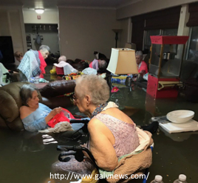
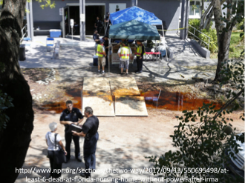
WHY?

Slide 4

Why?

Slide 5
Disclaimer
Any recommendations provided by NSPA are provided strictly as recommendations and facilities are under no obligation to comply with said recommendations. Participation in this exercise series does not guarantee approval by certification/licensing agencies or the ability of a facility to adequately response to an emergency and should not be construed as being approved by CMS, VDH Office of Licensure and Certification, or any other licensing, certifying, or governing body. It is the responsibility of the healthcare facility to ensure that they are adequately prepared to respond to an emergency and have met all provisions of licensing and certifying agencies.

Slide 6
Near Southwest Preparedness Alliance
Connect with us:
Weekly Situational Brief: www.nspa1.org/brief
Email ListServ: www.nspa1.org/register

Slide 7

Overview of Entire Process

Slide 8
Table Top Exercise
What is it?
Why TTX?

Slide 9
TTX: Evacuation/Shelter-in-Place
Agenda:
T = -0:30 Registration
T = 0:00 TTX Rules/Guidelines
T = 0:10 – 2:00 Modules/Discussions
T = 2:10 Hot Wash

Slide 10
TTX Checklist
Review/Bring:
Emergency Operations Plan (EOP)
EOP Annexes and Appendices
Organization Chart
ICS Information
Communication Plan
MOUs
Roles and Responsibilities
www.nspa1.org/2018exerciseresources

Slide 11
Documentation
NSPA Will Provide:
AAR Boilerplate with general exercise information
Attendance logs for TTX
A letter detailing the entire effort and a certificate of completion on 11/09.
You Are Responsible For:
Sign-in sheets for webinar
Lessons learned and Improvement Plans for the AAR documents
Final/permanent custodial duties for documentation

Slide 12

Final Notes
September 25 or September 27 or September 28
Vinton War Memorial
814 E. Washington Avenue
Vinton, VA 24179

Slide 13
Questions?

